Slide 1
y
(x₂,y₂)
θ₁
L₁
(x₁,y₁)
L₀
θ₀
x

Slide 2
y
(x₂,y₂)
L₁
L
α
β
L₀
θ₀
x

Slide 3
(x₂,y₂)
L₁
L
θ₁
ζ
L₀

Slide 4
a₂
a₄
z₂
y₂
x₂
z₁
a₃
y₁
x₁
a₁
z₀
θ₁
y₀
x₀
θ₀

Slide 5
x₂
y₂
COM₄
COM₃
θ₁
y₁
L₁
x₁
COM₂
COM₁
y₀
θ₀
x₀
L₀

Slide 6


x₂
y₂
$\frac{1}{2}$L₁
y_{β}
x_{β}
θ₁
$\frac{1}{2}$L₀
y₁
L₁
x₁
x_{α}
y₀
θ₀
x₀
L₀

Slide 7
(x₂,y₂)
(x₁,y₁)

Slide 8
Motor Shaft
Positions (rad)
Desired
Global
Positions
x_{d},y_{d}
Inverse
Kinematics
θ_{0d},θ_{1d}
θ_{0e},θ_{1e}
C
u₀,u₁
Plant
+
-
θ_{0A},θ_{1A}
Joint
Angle
Sensors

Slide 9
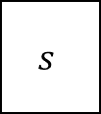
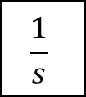
θ_{0e},θ_{1e}
PID Joint
Position
Controllers
u₀,u₁
=
Kp
Proportional
θ_{0e},θ_{1e}
$$\frac{1}{s}$$
Ki
Integral
+
u₀,u₁
+
+
$$s$$
Kd
Derivative

Slide 10
F_{ext}
Desired Position
Desired Position
Due to F_{ext}
m
k
c

Slide 11
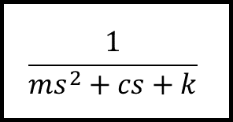
Admittance filter
$$\frac{1}{{ms}^{2}+cs+k}$$
F_{ext}
Position
Demand
(P_{D})
Desired
Position
(P_{T})
+
Position
Controller
Plant
+
-
Actual position (P_{A})

Slide 12
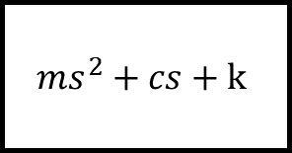
Impedance filter
$${ms}^{2}+cs+k$$
P_{ext}
Force
Demand
(F_{D})
Desired
Force
(F_{T})
+
Force
Controller
Plant
+
-
Actual Force (F_{A})

Slide 13
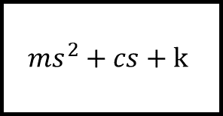
Impedance filter
$${ms}^{2}+cs+k$$
P_{ext}
Force
Demand
+
Force
Controller
Plant
Desired
Force
+
-
Actual Force

Slide 14
High Level Controller
Task Encoding
Low Level Controller
Hardware
Work Object
External Environment

Slide 15
End Effector
Desired Path
Geometric Calculation
k_{imp}
System Model
PI Controller
System
F_{a}
Δr
F_{d}
i_{d}
i_{e}
+
-
i
Joint angles

Slide 16
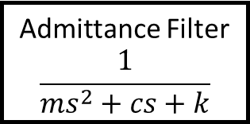
x_{p}
y_{p}
x_{d}
y_{d}
θ_{0d}
θ_{1d}
θ_{0e}
θ_{1e}
u₀
u₁
Motor Shaft
Position Output
Desired
Global
Positions
Inverse
Kinematics
PID Joint
Position
Controllers
Plant
+
+
+
-
Force Output
θ_{0A}
θ_{1A}
Joint
Angle
Sensors
x_{i}
y_{i}
θ_{0A}, θ_{1A}
Forward Kinematics
x_{A}, y_{A}
F_{x}
F_{y}
Admittance Filter
$$\frac{1}{{ms}^{2}+cs+k}$$
End Effector Force Sensor (and force resolution)

Slide 17
High Level Controller
Task Encoding/Trajectory Generation
Low Level Controller

Slide 18
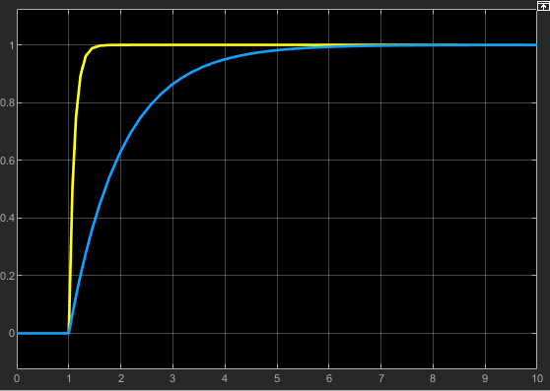

Displacement (m)
k = 10 N/m, c = 1 Ns/m
k = 10 N/m, c = 10 Ns/m
Time (s)

Slide 19
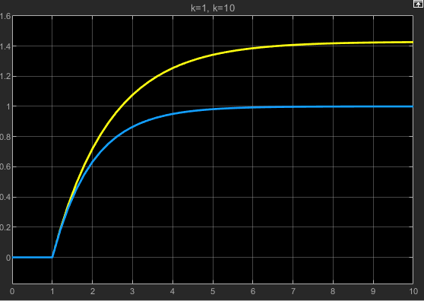
Displacement (m)
k = 7 N/m, c = 10 Ns/m
k = 10 N/m, c = 10 Ns/m
Time (s)

